Slide 1
DIAS: Decentralized Internet Applications and Services
Final Project Presentation
3/13/14
Adriana Flores
Clayton Shepard
Ellis Giles
Haiuhua Shen
Yanda Lu

Slide 2
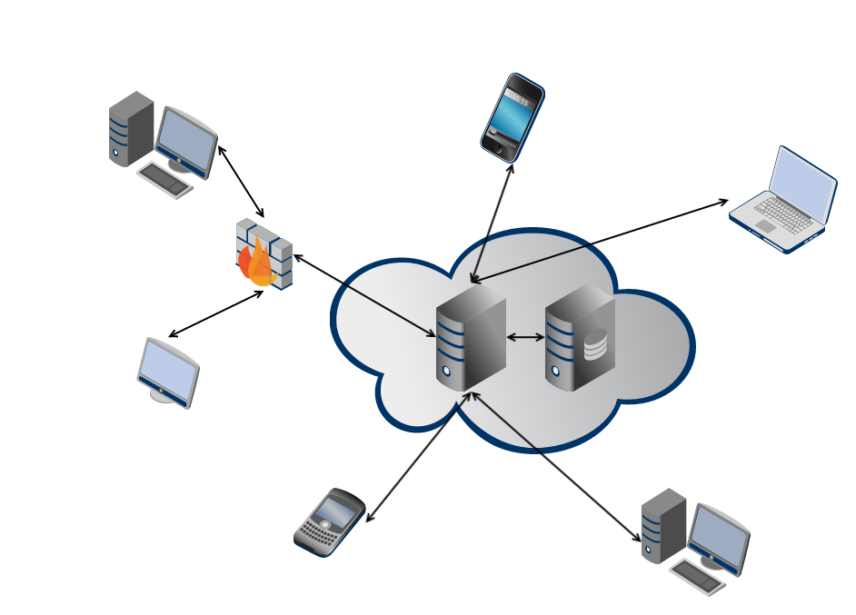
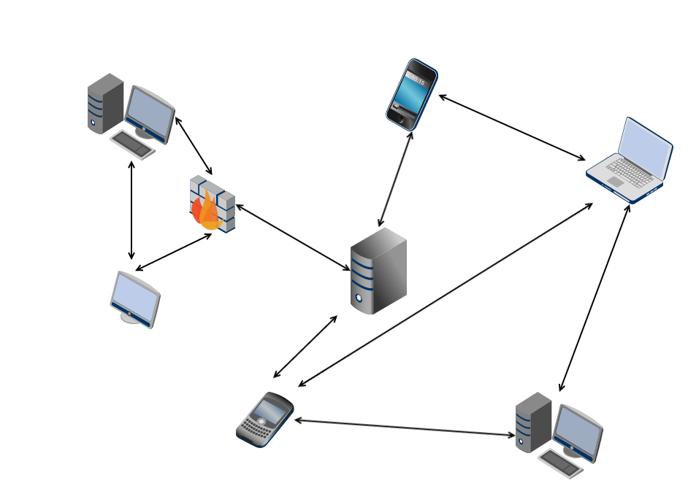
Problem
Centralized Architecture
Single point of failure
✗ Privacy
✗ Security
✗ Energy efficiency
Decentralized Architecture
Robust to failure
Reclaim personal data
Power efficiency
Notes:
. Use 2 minutes to remind audience the problem/question that you want to address
====
centralized servers have many drawbacks, ranging from
privacy, security, and fault-tolerance, to even energy-efficiency
and control over data
Power-hungry data centers
According to Google their global data center operation electrical power ranges between 500 and 681 megawatts.
Decentralize the current server-client mode paradigm in the current Internet

Slide 3
DIAS: Decentralized Internet Applications and Services
Goal:
Decentralize the current server-client model
Replace servers with point to point communication for personal communication and services
Email, Web Pages, Social Networking, Chat, VoIP
Benefits:
Security, Privacy, Resilience, Cost, and Power
Challenges:
Redundancy, Uptime, Failover, Battery Management
Notes:
. Use 2 minutes to remind audience the problem/question that you want to address
=========
How do we ensure reachability?
What happens if the cellphone loses connectivity?
What if it is lost/broken/stolen?
We need to find novel methods to ensure redundancy for both uptime and data.
Redundancy
Uptime
Data

Slide 4
DIAS Architecture
Ellis
Notes:
. Use 10 minutes to explain in detail your solution or approach to address the problem/question

Slide 5
DIAS Implemented Services
Web – Nano and iJetty
Email - JES
SSH
Proxy
P2P

Slide 6
DIAS: Web Server
Yanda
Ellis

Slide 7
DIAS: Email Server
Adriana

Slide 8
VPN Server
PPP, xl2tpd, and openswan (ipsec)
Fairly Standard
Small caveats
VPN end point on network (routing loop)
1 to 1 NAT

Slide 9
DNS Server
Fairly Standard BIND9 server
Lots of scripting to setup naming architecture
Name | Type | Value | Description
clay.elec529 | A | 168.7.138.104 | Main host record
m.clay.elec529 | A | 168.7.138.104 | Permanent master record
1.clay.elec529 | CNAME | adriana.elec529 | First failover
n.clay.elec529 | CNAME | node.elec529 | Nth failover
clay.elec529 | MX | clay.elec529 | Mail, priority, 1
clay.elec529 | MX | 1.clay.elec529 | Mail failover, priority 10

Slide 10
Dynamic DNS Failover
nsupdate to make changes without reloading server
/etc/ppp/ip-up runs nsupdate to change ips
API provided to Android for other changes
E.g. battery based failover

Slide 11
VM Test Environment
Not enough phones
Spin up VMs on same IPs
Test JES, ssh, etc.

Slide 12
DIAS: SSH Server
Keys, paths, permissions, and env!
Very hard to get right.
Provides authentication for everything
Based on OpenSSH
Thread sets config, then monitors it.

Slide 13
DIAS: Data Replication (rsync)
Keys, paths, permissions, and env!
Yes, again. This was hard. And ridiculous.
Runs over SSH
Public Key Authentication
Very efficient
Diffs files, and only sends modified blocks
Two Modes: full and sparse replication
Notes:
To get rsync to work:
Had to use dropbear client
Had to run from shell. (and had to call from shell)
Tons of weird errors (for example dos format).

Slide 14
DIAS: Proxy Server
Ellis

Slide 15
DIAS: Peer to Peer
Haihua
Ellis

Slide 16
DIAS: Android APP
MAIN TAB…
Ellis & adriana

Slide 17
DIAS DEMO
Download of APP in this website:
Set your device name:

Slide 18
DIAS DEMO
Try Web Service:
Try SSH Service

Slide 19
DIAS DEMO
Failover
Recovery

Slide 20
Summary
Take-home points
Lessons learned
Future Directions
Conclusions
Notes:
. Use 3 minutes to summarize take-home points, discuss lessons learned, future directions, and conclusions

